Slide 1
The number of people aged 50 and over
in England
Our ageing population
increased by
7 million in the last 40 years.
21.4 million
14.6 million
1981
2021
For source see chart 2.01 here: https://ageing-better.org.uk/our-ageing-population-state-ageing-2023-4

Slide 2
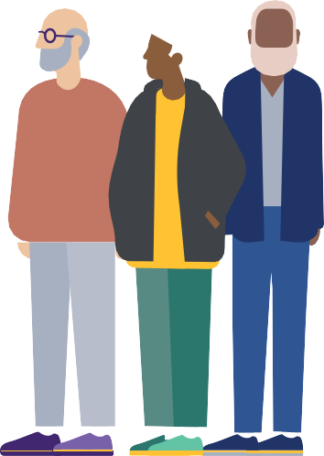
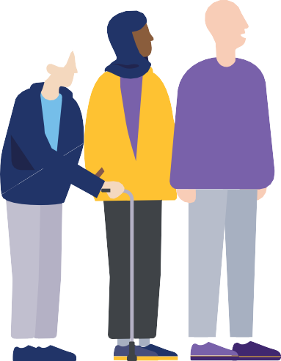
Our ageing population
The changes in the age structure that we have seen over the last 40 years are set to continue over the next 40 years.
Projected increase in population between 2023 and 2063
100%
30%
65-79
80+
For source see chart 2.02 here: https://ageing-better.org.uk/our-ageing-population-state-ageing-2023-4

Slide 3
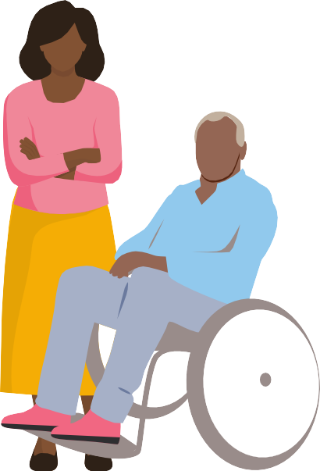
Our older population is becoming
more ethnically
Our ageing population
80%
diverse.
The number of people aged 60 and over with Black, Asian and Minority Ethnic backgrounds in England increased by 80% between 2011 and 2021.
1m+
0.6m
2011
2021
For source see chart 2.04 here: https://ageing-better.org.uk/our-ageing-population-state-ageing-2023-4

Slide 4
177,810
Our ageing population
Diversity in sexual orientation and gender identity among older people is set to increase.
Among people aged 45-64 in England, over four times as many identify as LGB+ and over twice as many identify as trans, as among those currently aged 65 and over.
Over 55s identify as LGB+
48,550
Over 55s identify as trans
For source see chart 2.07 here: https://ageing-better.org.uk/our-ageing-population-state-ageing-2023-4

Slide 5
Our ageing population
Almost 5 million
people aged 50 and over live alone in England – almost a quarter (23%) of this age group.
The number of people living alone has increased over time: the largest increase between 2011 and 2021 was among men aged 65 and over.
For source see chart 2.10 here: https://ageing-better.org.uk/our-ageing-population-state-ageing-2023-4

Slide 6
Our ageing population
Almost one in five women aged 50-64 in England is an unpaid carer.
Among these women:
those living in deprived areas
those from minority ethnic groups with the worst health*
are most likely to provide 50 or more hours of unpaid care per week.
*White Gypsies and Irish Travellers, Bangladeshi and Pakistani people.
For sources see charts 2.14 and 2.15 here: https://ageing-better.org.uk/our-ageing-population-state- ageing-2023-4 and chart 7.03 here: https://ageing-better.org.uk/society-state-ageing-2023-4

Slide 7
Work
Employment rate of people aged 50-64
Employment rates of older age groups improved over the past two decades, but this was stalled by the pandemic.
2000
2001
2002
2003
2004
2005
2006
2007
2008
2009
2010
2011
2012
2013
2014
2015
2019
2017
2018
2019
2020
2021
2022
2023
Covid-19
pandemic
72%
71%
60%
*March-May 2023.
For source see chart 3.02 here: https://ageing-better.org.uk/work-state-ageing-2023-4

Slide 8
Work
Employment rates vary widely across ethnic groups, the result of discrimination and inequalities across the life course.
For source see chart 3.04 here: https://ageing-better.org.uk/work-state-ageing-2023-4
Employment rates of selected ethnic groups, England, 2021
74%
70%
68%
65%
65%
55%
29%
National Average
Black Caribbean
National Average
20%
Bangladeshi
Bangladeshi
Chinese
Chinese
Pakistani
50-64 year old men
50-64 year old women

Slide 9
Work
297,000
Sickness is the main reason that people aged 50-64 are economically inactive.
This number increased from just over 1.1 million in 2019 to 1.32 million in 2022. Those on lower incomes are more likely to have left or be considering leaving work because of ill health than those on highers incomes
Number of people aged 50-64 who would like to be working but aren’t, by reason
76,000
26,000
Looking after family and/
or home
Sick, injured or disabled
Retired
* Economically inactive means neither working nor looking for work.
For sources see charts 3.06, 3.10 and 3.12 here: https://ageing-better.org.uk/work-state-ageing-2023-4

Slide 10
Work
People aged 50 and over who are looking for work are less likely to secure employment than those aged under 50.
For sources see charts 3.15 and 3.16 here: https://ageing-better.org.uk/work-state-ageing-2023-4
Percentage of people who got a job through the Work and Health programme within 24 months between November 2017 and February 2021.
32%
24%
21%
17%
18-24
50-54
55-59
60+

Slide 11
Work
Older workers are the least likely to receive on-the-job training.
Over one-fifth (22%) of 18-24 year old workers in the UK received job-related training in early 2023 compared to just 15% of 50-64 year old workers.
For source see chart 3.24 here: https://ageing-better.org.uk/work-state-ageing-2023-4

Slide 12
Self- employment becomes more common with age.
Work
57%
Percentage of workers in the UK who are self-employed as their main job
45%
23%
But rates of self-employment have declined in all age groups since the start of the pandemic.
16%
14%
10%
6%
16-29
30-39
40-49
50-59
60-69
70-79 80+
For source see chart 3.22 here: https://ageing-better.org.uk/work-state-ageing-2023-4

Slide 13
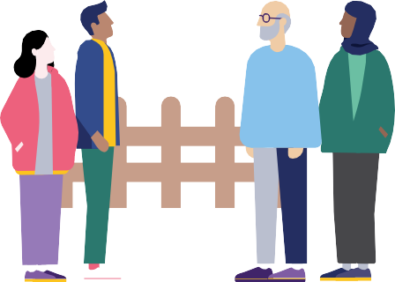
Homes
There are 3.5 million non-decent homes in England: half are headed by someone aged 55 and over.
Homes are classed as non-decent for one of four reasons:
A serious hazard which poses a risk to health.
Not providing a reasonable degree of thermal comfort.
In disrepair.
Not having sufficiently modern facilities.
For source see chart 4.03 here: https://ageing-better.org.uk/homes-state-ageing-2023-4

Slide 14
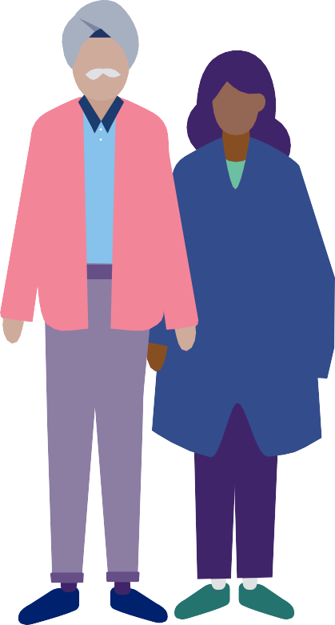
Homes
In England there are
1.3 million owner occupied homes headed by someone aged 55 or over
that are non-decent.
A fifth of owner-occupied homes headed by someone 55 or over in the lowest income bracket are non-decent, compared to a tenth in the highest income bracket.*
* income brackets in fifths.
For sources see charts 4.03 and 4.08 here: https://ageing-better.org.uk/homes-state-ageing-2023-4

Slide 15
Homes
A quarter of a million privately rented homes headed by someone aged 55 and over in England are non-decent.
Two in five homes privately rented by someone aged 50-69
have condensation, damp or mould. The number of private renters aged 50 and over doubled in the 20 years to 2021 and is set to continue to increase.
For sources see charts 4.03, 4.05 and 4.09 here: https://ageing-better.org.uk/homes-state-ageing-2023-4

Slide 16
Homes
36.4%
Nearly one in five people aged 50 and over from Black, Asian and Minority Ethnic backgrounds in England is living in housing deprivation.
26.9%
19.4%
10.3%
5.3%
3.5%
Bangladeshi Pakistani
BAME
Black Caribbean
All
White British
A household is classified as deprived in the housing dimension if the household’s accommodation is either overcrowded, in a shared dwelling, or has no central heating. Selected ethnic groups shown; see source for others. For source see chart 4.06 here: https://ageing-better.org.uk/homes-state-ageing-2023-4

Slide 17
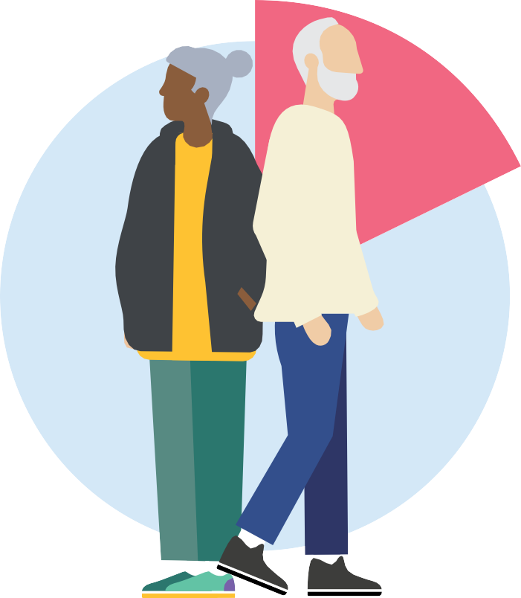
Homes
Almost 2 in 5 pension-age adults who are renting privately were in relative poverty in the UK in 2020/21.
37%
of those privately renting
36%
of those socially renting
18%
13%
of owner- occupied
of pensioners overall are in relative poverty
For sources see charts 4.13, 4.14 and 4.15 here: https://ageing-better.org.uk/homes-state-ageing-2023-4

Slide 18
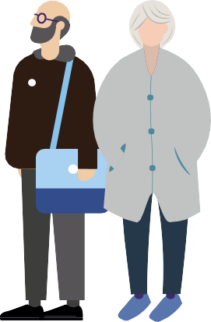
A
Homes
0% 10% 20% 30% 40% 50% 60% 70% 80% 90% 100%
Older people are the most likely to
live in the
hardest to heat homes.
41% of homes
54% of homes headed by someone aged 54 or younger
headed by someone
B
Vs
aged 75 and over are energy efficient (bands A to C)
C
D
E
Homes headed by someone aged 75 or over are twice as likely to have the
F
lowest energy ratings (bands E to G;
16%) as homes headed by someone
G
aged 54 or younger (8%).
For source see chart 4.17 here: https://ageing-better.org.uk/homes-state-ageing-2023-4

Slide 19
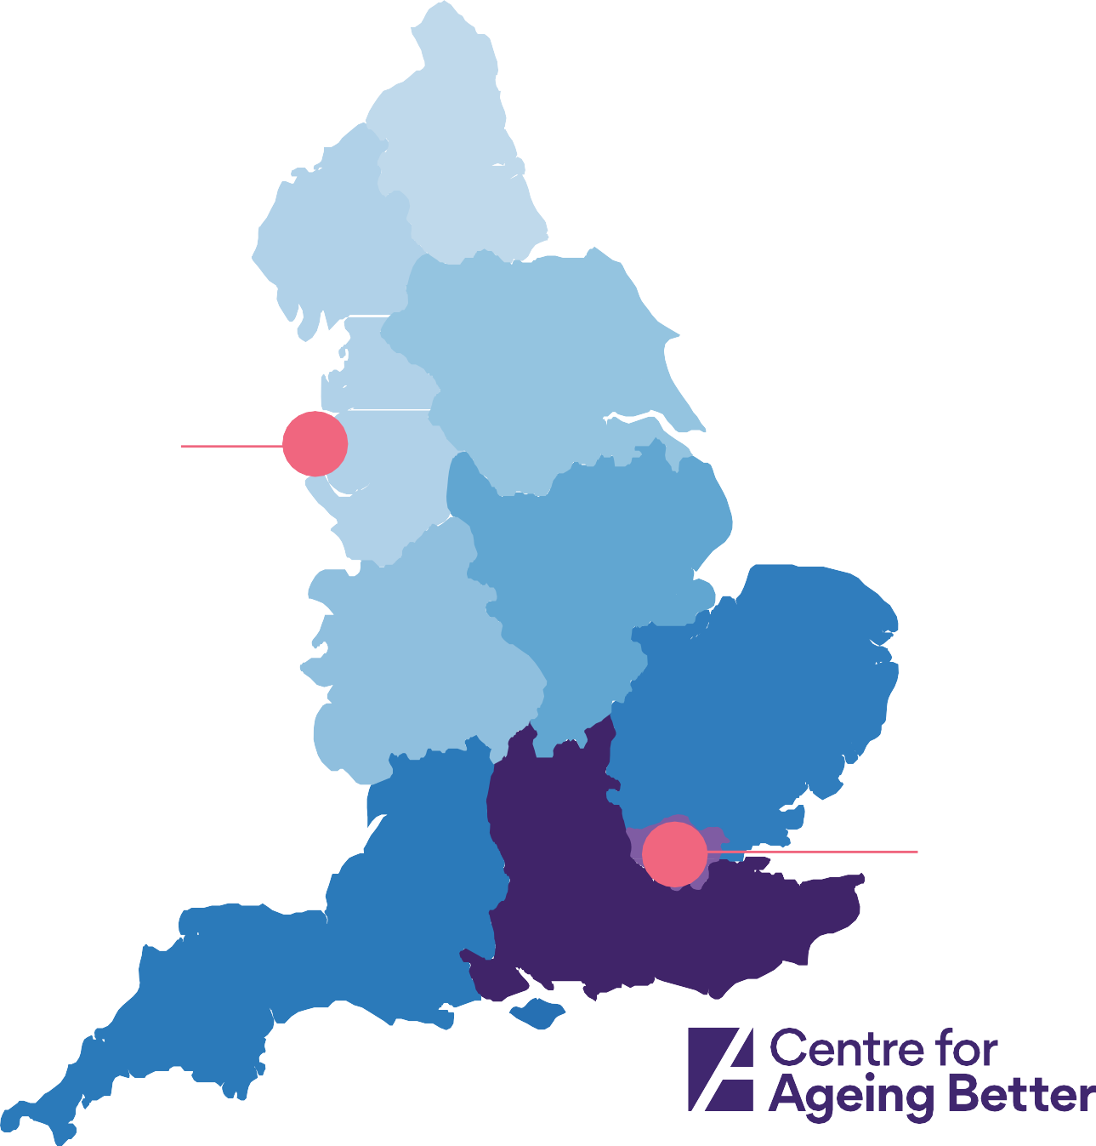
Health
77.9
Men living in more deprived areas live
shorter lives.
We see the same pattern for women for whom life expectancy ranges from 81.5 in the North East to 84.3 in London.
77.6
Lowest male life expectancy
78.4
74.1
Blackpool
79.2
78.5
80.2
Highest male life expectancy
84.7
80.6
Westminster
80.3
Source: https://ageing-better.org.uk/health-and- wellbeing-state-ageing-2023-4 ONS (2022).
Health state life expectancies, UK: 2018-2020. Available at: https://www.ons.gov.uk/peoplepopulationandcommunity/ healthandsocialcare/healthandlifeexpectancies/bulletins/ healthstatelifeexpectanciesuk/2018to2020

Slide 20
People living in the least deprived areas of England spend more of their lives in
good health than
Health
Years spent in good health for women at birth in the poorest and wealthiest areas, England, 2018/20
Not in good health In good health
15.6
years
26.4
years
70.7
years
51.9
those in the most deprived areas.
For source see chart 5.03a here: https://ageing-better.org.uk/health-and-wellbeing-state-ageing-2023-4
years
Least deprived areas
Most deprived areas

Slide 21
Health
Percentage of women aged 65 and over from selected ethnic groups who are in bad health
Bangladeshi and Pakistani women in England are most likely to experience bad health as they age.
37%
Bangladeshi
31%
13%
Pakistani
White British
9%
Chinese
For source see chart 5.04 here: https://ageing-better.org.uk/health-and-wellbeing-state-ageing-2023-4

Slide 22
Health
Percentage of people aged 60-64 who are disabled
Rates of disability among people in their 50s in the most deprived areas are equal to those of people 25 years older in the least deprived areas.
For source see chart 5.08 here: https://ageing-better.org.uk/health-and-wellbeing-state-ageing-2023-4
41%
15%
Most deprived areas
Least deprived areas

Slide 23
29%
Health
The cost-of- living crisis is making
people’s mental
and physical health worse.
of all people aged 50-69 in the UK say their mental health has become worse.
23%
of all people aged 50-69 in the UK say their physical health has become worse.
For sources see charts 5.17a and 5.17b here: https://ageing-better.org.uk/health-and-wellbeing-state-ageing-2023-4

Slide 24
Health
Over 230,000
carers aged 50 and over in England are in bad or very bad health themselves.
Number of people in bad or very bad health who also provide 50 or more hours of care per week
50k
33k
28k
11k
50-64
65-74
75-84
85+
For source see chart 5.12 here: https://ageing-better.org.uk/health-and-wellbeing-state-ageing-2023-4

Slide 25
Financial Security
Almost one in five pensioners in the UK lives in relative poverty.
The poverty rate for single pensioners (25%) is almost double that for couple pensioners (14%).
Relative poverty is an income below 60% - and deep poverty an income below 50% - of median income after housing costs For source see charts 6.01a and 6.01b here: https://ageing-better.org.uk/financial-security-state-ageing-2023-4

Slide 26
28% 26%
Financial Security
Over a quarter of people aged 50 and over from Pakistani and Bangladeshi backgrounds in
the UK were living
in deep poverty in 2021/22.
Deep poverty is an income below 50% of median income after housing costs
For source see chart 6.03 here: https://ageing-better.org.uk/financial-security-state-ageing-2023-4
13%
Pakistani
Bangladeshi
Total population

Slide 27
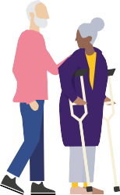
Financial Security
Population average
£18,100
Some groups, including Disabled people and divorced women, have lower than average income from their pensions and other benefits.
For source see chart 6.06a here: https://ageing-better.org.uk/financial-security-state-ageing-2023-4
£17,600
£16,400
£15,000
£15,150
£15,650
£13,600
Minority ethnic background
Divorced women
Disabled people
Self-employed
Carers
Women

Slide 28
Financial Security
Full state pension only gets pensioners to 80% of
the Minimum
Income Standard.
So pensioners wholly reliant on state pension (plus Pension Credit) will have to cut back on spending that is viewed as essential.
The Minimum Income Standard
(MIS) is based on a basket of goods
and services that the public thinks is
the minimum needed for an acceptable
standard of living in the UK today.
Currently (2023), the MIS for a single
pensioner is £256 per week and
that for a pensioner couple is
£401 per week.
For source see chart 6.08 here: https://ageing-better.org.uk/financial-security-state-ageing-2023-4

Slide 29
Financial Security
1 million people eligible for Pension Credit are not claiming it.
Three times as many single women as single men are not receiving Pension Credit to which they are entitled, compounding the financial disadvantage faced by older women.
150,000
Single men
400,000
People living as couples
450,000
Single women
are not claiming pension credit
Pension Credit tops up weekly income to £201.05 for a single person and tops up joint weekly income to £306.85 for a couple. For source see chart 6.09 here: https://ageing-better.org.uk/financial-security-state-ageing-2023-4

Slide 30
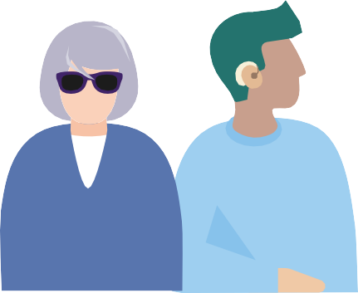
Financial Security
Households with at least one Disabled adult are more likely to have no savings.
31%
16%
Respondent (and partner) not disabled
Respondent (or partner) disabled
Percentage of people aged 50 to 69 who have no savings
For source see chart 6.13 here: https://ageing-better.org.uk/financial-security-state-ageing-2023-4

Slide 31
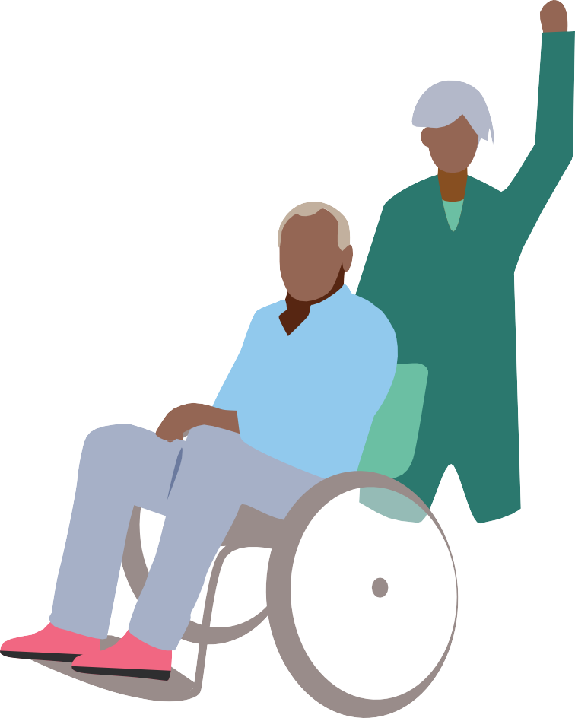
Society
Regular formal or informal volunteering
is most common
between the ages of 65 and 74.
But since the pandemic, overall rates of volunteering for this age group have not recovered to pre-pandemic levels.
Regular volunteering means at least once a month.
For source see chart 7.01 here: https://ageing-better.org.uk/society-state-ageing-2023-4

Slide 32
People aged 50 and over are more likely to say they have experienced ageism in the last year
if they are disabled,
Society
Population average
46%
Disabled, with conditions that affect daily activities a lot
73%
Struggling financially
63%
struggling financially, or from Black, Asian and Minority Ethnic (BAME) backgrounds.
For source see chart 7.07b here: https://ageing-better.org.uk/society-state-ageing-2023-4
BAME
58%

Slide 33
Society
The proportion of people
who feel they
belong to their neighbourhood increases with age.
But the gap between the youngest and oldest has been narrowing over time.
71%
69%
63%
65%
54%
25-34
35-49
50-64
65-74
75+
For sources see chart 7.09 here: https://ageing-better.org.uk/society-state-ageing-2023-4

Slide 34
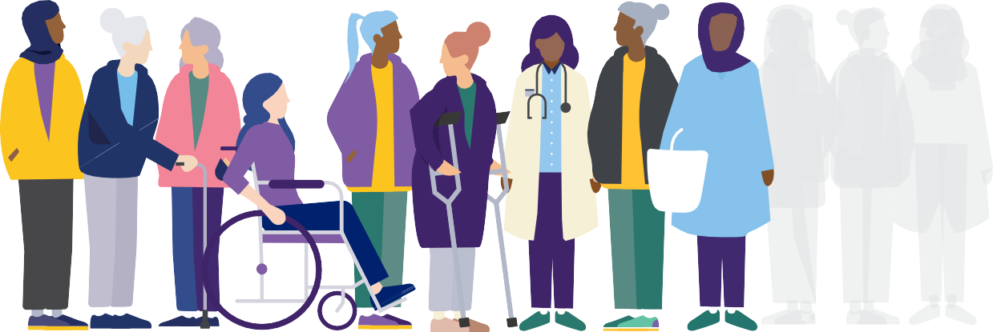
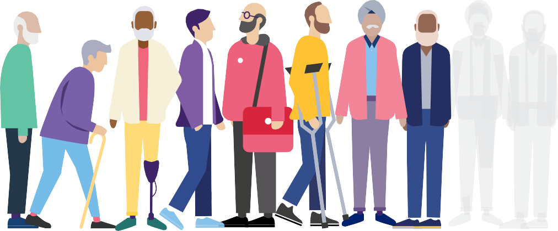
Society
As they age, men are less likely than women to say that they have people to rely on if they need help.
For source see chart 7.10 here: https://ageing-better.org.uk/society-state-ageing-2023-4
78% of women and only 66% of men
aged 65-74 in England have someone to rely on

Slide 35
Society
Local authority spending on many community
services continues
to decline.
These services play valuable roles in enabling older people to stay engaged unities, and in promoting better health and wellbeing.
Real terms Local Authority spending in 2022/23 compared to 2010/11
Culture and heritage
Community centres and halls
Community development
Open spaces
Library services
Public toilets
-20%
-28%
-29%
-45%
-45%
-51%
For source see chart 7.14 here: https://ageing-better.org.uk/society-state-ageing-2023-4

Slide 36
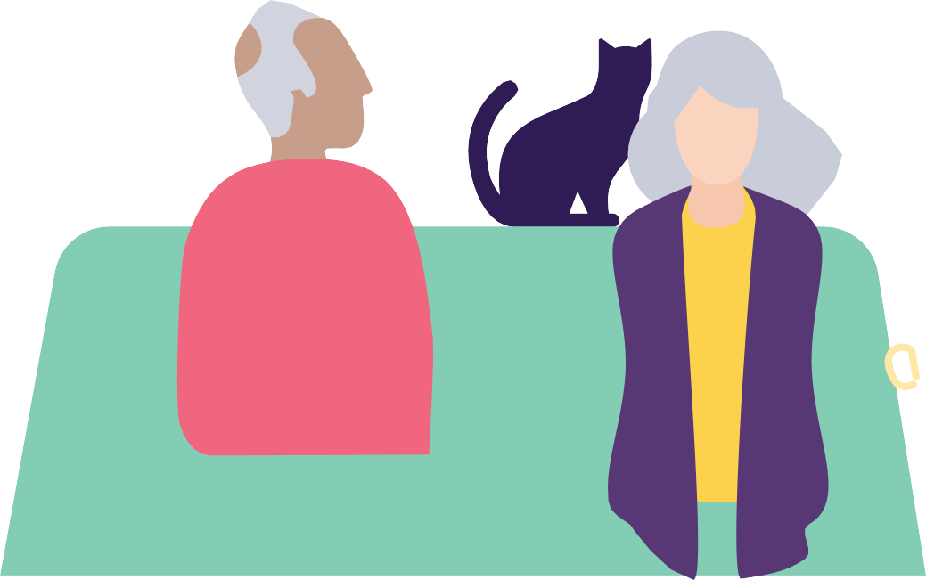
Society
Just half of people aged 75 and over have all the basic digital skills needed to operate online.
This compares with seven in ten people aged 55-64.
For source see chart 7.16 here: https://ageing-better.org.uk/society-state-ageing-2023-4

